Slide 1
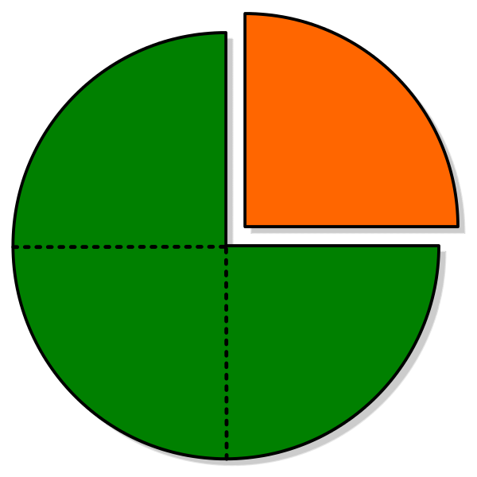
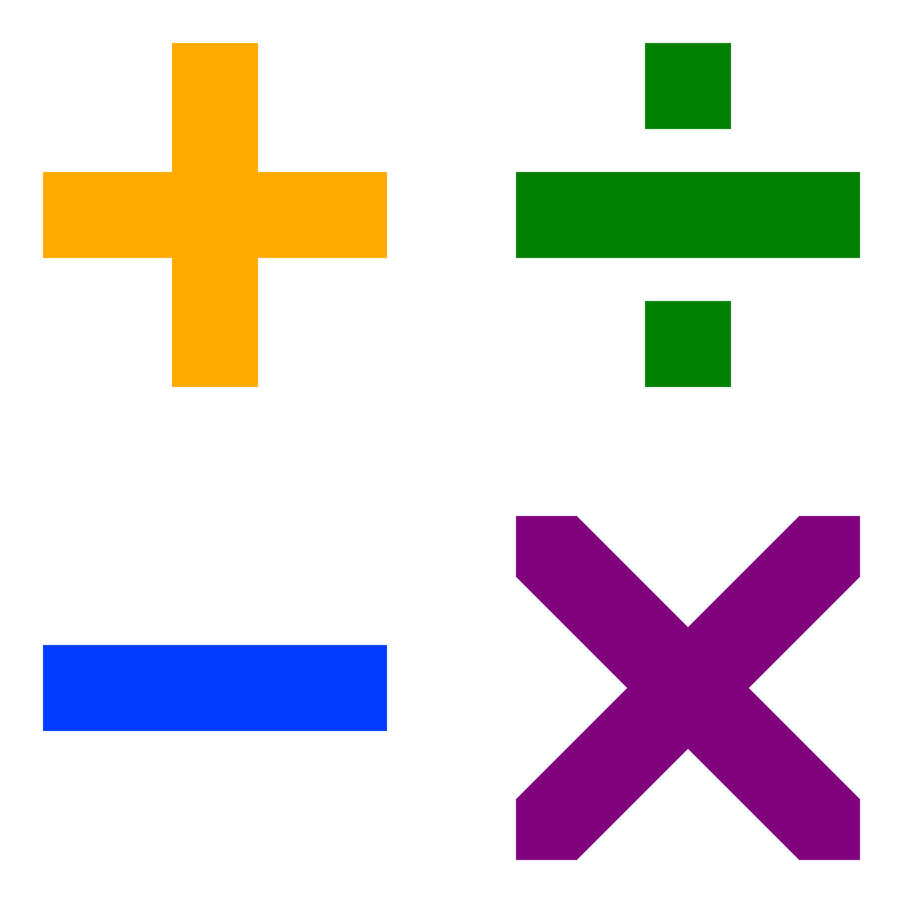
Knowledge Tracing on Fractions
Akshit Arora & Shirly Montero-Quesada

Slide 2

Instructional Design
knowledge state

Slide 3
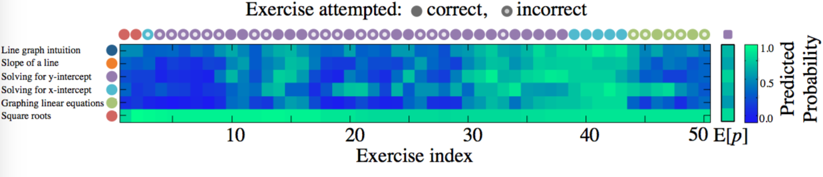
Deep Knowledge Tracing- Piech et al
C. Piech, J. Bassen, J. Huang, S. Ganguli, M. Sahami, L. J. Guibas, and J. Sohl-Dickstein. Deep knowledge tracing. In C. Cortes, N. D. Lawrence, D. D. Lee, M. Sugiyama, and R. Garnett, eds., Advances in Neural Information Processing Systems 28, pp. 505–513. Curran Associates, Inc., 2015.

Slide 4
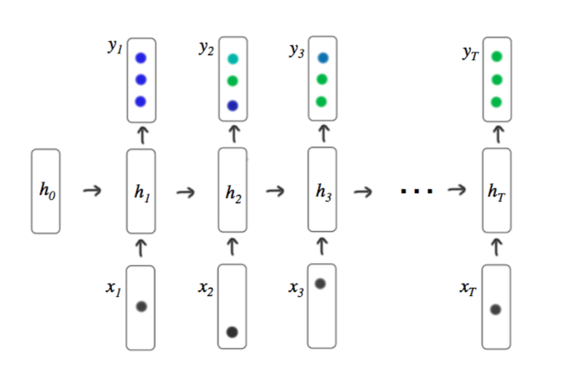
DKT - RNN
C. Piech, J. Bassen, J. Huang, S. Ganguli, M. Sahami, L. J. Guibas, and J. Sohl-Dickstein. Deep knowledge tracing. In C. Cortes, N. D. Lawrence, D. D. Lee, M. Sugiyama, and R. Garnett, eds., Advances in Neural Information Processing Systems 28, pp. 505–513. Curran Associates, Inc., 2015.

Slide 5

Wootmath
Boulder startup, founded 2013; funding from the NSF, the US Dept. of Ed, and Foundry Group (VC)
Adaptive instructional software
Goal is to enable all students to master fractions and related concepts
~1M Student Sessions from 2016-17 school year
~50k students from grades 3-6

Slide 6
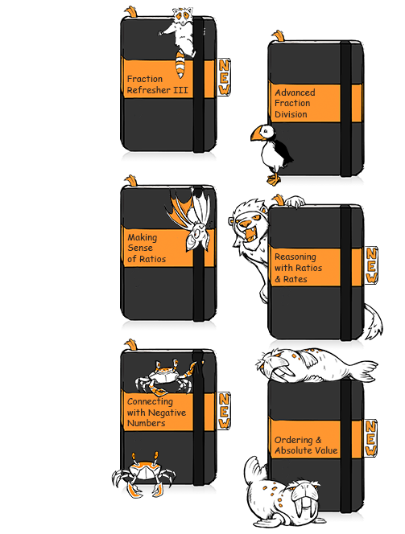
Content is organized into “Books.” Books are units of study.
Each Book has an ordered, main sequence of Lessons
which may get adaptively augmented
Just-in-time help
Supplementary lessons
www.wootmath.com
Notes:
Woot Math content is organized and presented to students and teachers as books – currently 23 books (fractions, decimals, ratios, and rational numbers).
Across the books, a total of a few hundred lessons are organized into a STANDARD progression.
These are augmented by supplemental content in the form of additional lessons and just-in-time help for students who need it.
The system is adaptive, but adapts around a fixed core of content.
Each lesson contains multiple instructional videos and problem sets.
Some students may see less of the content because of adaptive acceleration.

Slide 7
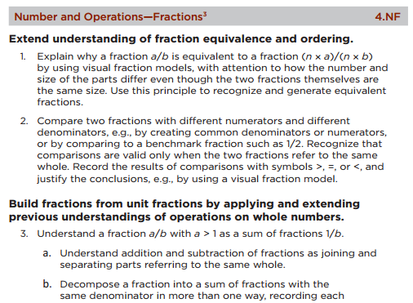
Lessons are labeled with identifiers referencing the Common Core State Standards
“4.NF.3.a”
www.wootmath.com
Notes:
The lessons and problem sets are labeled with expert data.
In particular, the content is labeled with Common Core State Standards tags.
These are a hierarchical organization of all K-12 mathematics content like the example shown here.

Slide 8
Dataset and Input
10 most popular tasks
612 problems
4 labels
1255 students (90% training set, 10% test set)
Encode "scaled" one-hot of length 612 + "scaled" one-hot of length 4
1 if correct first try
0.6 is correct second try
0.3 if incorrect
Feed sequences (with padding)
Notes:
{'ccssm': 'CCSS.Math.3.NF.A.1', 'untouched': False, 'qual_id': '1zsCldT4p8.set2.JiTh5Wk0bD', 'time_spent': 31732, 'correct': False, 'ts': 1473782027923.0, 'task_id': '1zsCldT4p8.set2', 'second_try': False}

Slide 9
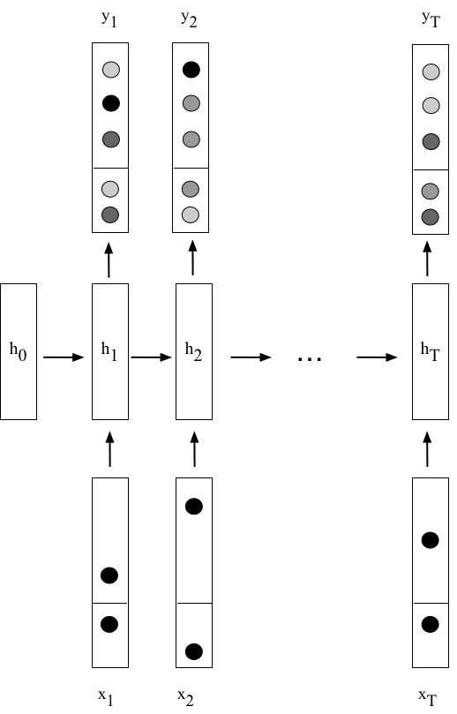
Our RNNs
RNN
Vanilla RNN
LSTM
Optimizer
MomentumOptimizer
AdagradOptimizer

Slide 10
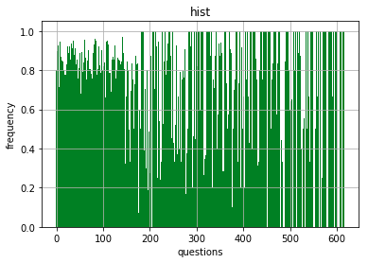
Accuracy - AUC
 | Stupid predictor (frequency of correctness) | DKT - RNN MomentumOptimizer | DKT -LSTM AdagradOptimizer
question level | 0.564 | 0.625 (0.117) | 0.655 (0.049)
CCSSM label level | 0.621 | 0.994 (0.009) | 0.997 (0.002)

Slide 11
More to do...
other techniques e.g. dropout, mini-batching and architectures
cross validation (didn't have time)
we assumed a closed set, 1-hot not pragmatic -> compressed sensing for larger dimensions
if set not closed (unannotated problems - new labels?)
more features (e.g time stamp, time duration, how the learner models the answer)

Slide 12
Thank you!
Mike Mozer
Mohammad Khajah
Sean Kelly
Brent Milne
Adam Holt

